Slide 1
Introduction to Data Analytics
Class #5
Descriptive Statistics II
Dr. Sreeja S R
Assistant Professor
Indian Institute of Information Technology
IIIT Sri City

Slide 2
Today’s discussion…
Measurement of location
Mean, median, mode, midrange, etc.
Measure of dispersion
Range, Variance, Standard Deviation, etc.
Other measures
MAD, AAD, Percentile, IQR, etc.
Graphical summarization
Box plot

Slide 3
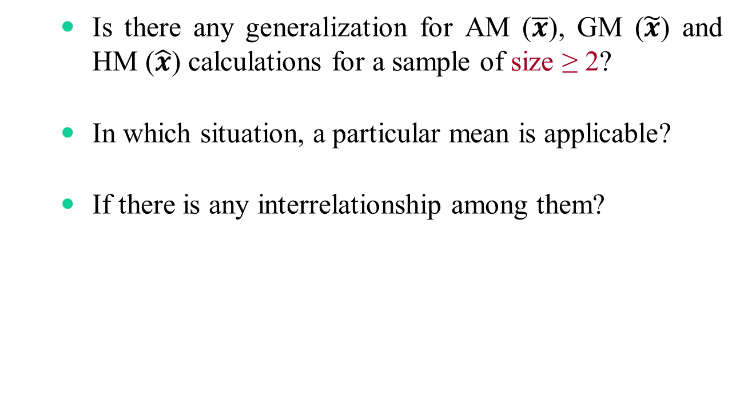
AM, GM and HM
Is there any generalization for AM ($\overline{x}$), GM ($\tilde{x}$) and HM ($\hat{x}$) calculations for a sample of size ≥ 2?
In which situation, a particular mean is applicable?
If there is any interrelationship among them?

Slide 4
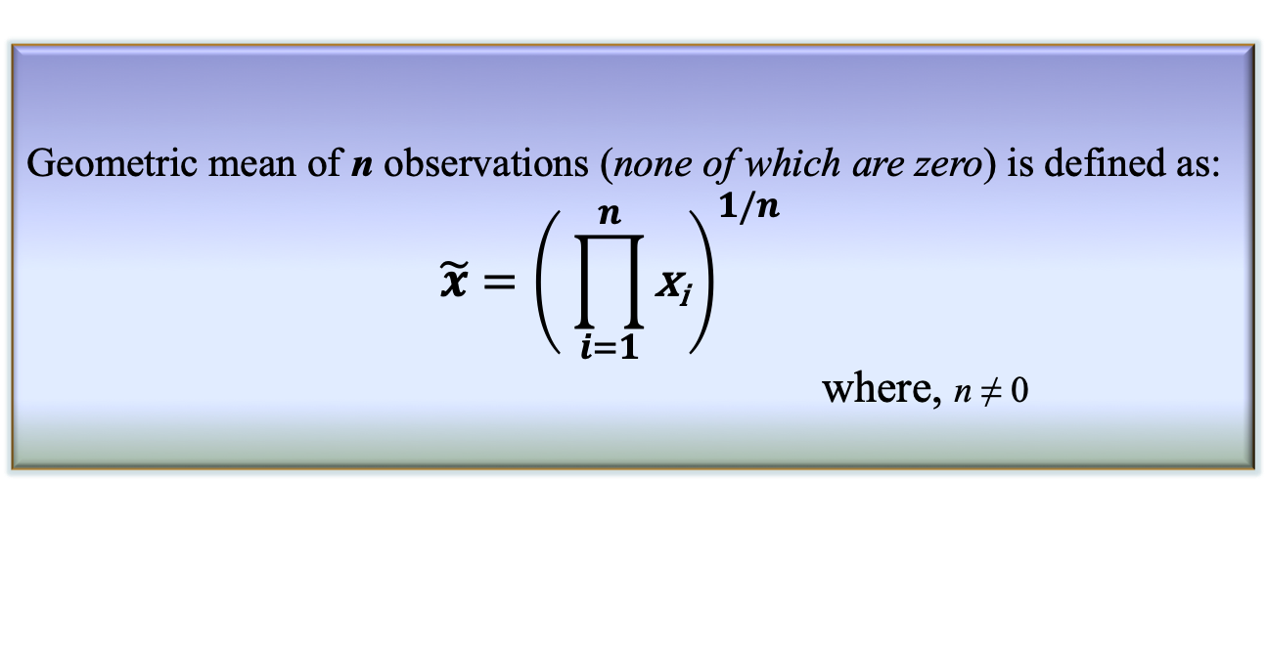
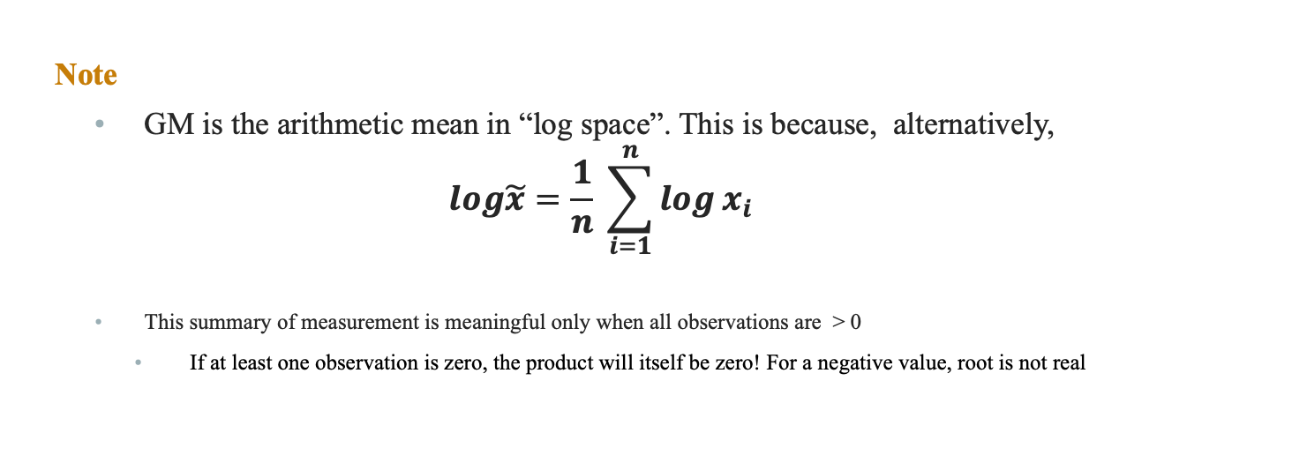
Geometric mean
Definition 3.9: Geometric mean
Geometric mean of n observations (none of which are zero) is defined as:
$$\tilde{x}={\left( \prod_{i=1}^{n}{\text{x}\text{i}}\right)}^{1/n}$$
where, n ≠ 0
Note
GM is the arithmetic mean in “log space”. This is because, alternatively,
$$log\tilde{x}=\frac{1}{n} \sum_{i=1}^{n}{\log{x_{i}} }$$
This summary of measurement is meaningful only when all observations are > 0
If at least one observation is zero, the product will itself be zero! For a negative value, root is not real

Slide 5
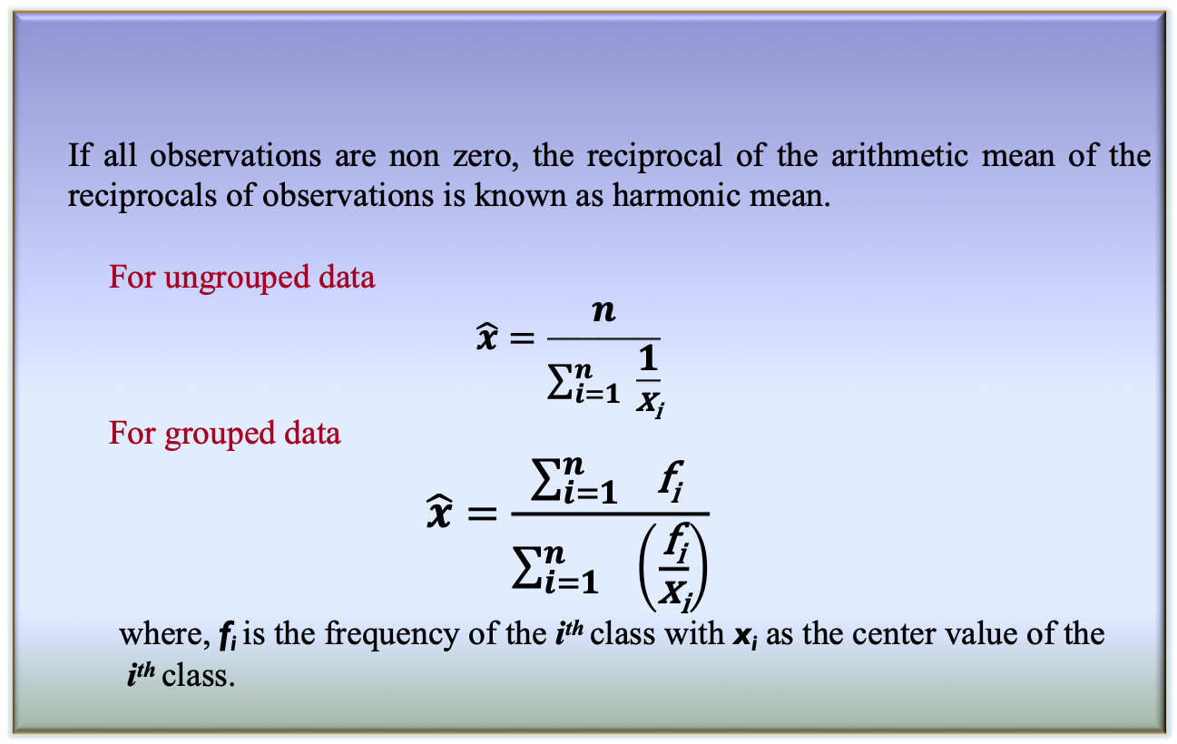
Harmonic mean
If all observations are non zero, the reciprocal of the arithmetic mean of the reciprocals of observations is known as harmonic mean.
For ungrouped data
$$\hat{x}=\frac{n}{\sum_{i=1}^{n}{ \frac{1}{\text{x}\text{i}}}}$$
For grouped data
$$\hat{x}=\frac{\sum_{i=1 }^{n}{\text{f}\text{i} }}{\sum_{i=1}^{n}{ }\left(\frac{\text{f}\text{i}}{\text{x}\text{i}}\right)}$$
where, $\text{f}\text{i}$is the frequency of the i^{th} class with $\text{x}\text{i}$ as the center value of the
i^{th} class.
Definition 3.10: Harmonic mean

Slide 6
Significant of different mean calculations
There are two things involved when we consider a sample
Observation
Range
Example: Rainfall data
Here, rainfall is the observation and day is the range for each element in the sample
Here, we are to measure the mean “rate of rainfall” as the measure of location
Rainfall (in mm) | r₁ | r₂ | … | r_{n}
Days (in number) | d₁ | d₂ | … | d_{n}

Slide 7
Significant of different mean calculations
Case 1: Range remains same for each observation
Example: Having data about amount of rainfall per week, say.
Rainfall (in mm) | 35 | 18 | … | 22
Days (in number) | 7 | 7 | … | 7

Slide 8
Significant of different mean calculations
Case 2: Ranges are different, but observation remains same
Example: Same amount of rainfall in different number of days, say.
Rainfall (in mm) | 50 | 50 | … | 50
Days (in number) | 1 | 2 | … | 7

Slide 9
Significant of different mean calculations
Case 3: Ranges are different, as well as the observations
Example: Different amount of rainfall in different number of days, say.
Rainfall (in mm) | 21 | 34 | … | 18
Days (in number) | 5 | 3 | … | 7

Slide 10

Rule of thumbs for means
AM: When the range remains same for each observation
Example: Case 1
Rainfall (in mm) | 35 | 18 | … | 22
Days (in number) | 7 | 7 | … | 7
$$\overline{r}=\frac{1}{n}\sum_{1}^{n}{r_{i}}$$

Slide 11

Rule of thumbs for means
HM: When the range is different but each observation is same
Example: Case 2
Rainfall (in mm) | 50 | 50 | … | 50
Days (in number) | 1 | 2 | … | 7
$$\tilde{r}=\frac{n}{\sum_{1}^{n}{\frac{1}{r_{i}}}}$$

Slide 12

Rule of thumbs for means
GM: When the ranges are different as well as the observations
Example: Case 3
Rainfall (in mm) | 21 | 34 | … | 18
Days (in number) | 5 | 3 | … | 7
$$\hat{r}={\left(\prod_{1}^{n}{r_{i}}\right)}^{\frac{1}{n}}$$

Slide 13
Rule of thumbs for means
The important things to recognize is that all three means are simply the arithmetic means in disguise!
Each mean follows the “additive structure”.
Suppose, we are given some abstract quantities {x₁, x₂, …, x_{n}}
Each of the three means can be obtained with the following steps
Transform each x_{i} into some y_{i}
Taking the arithmetic mean of all y_{i}’s
Transforming back the to the original scale of measurement

Slide 14
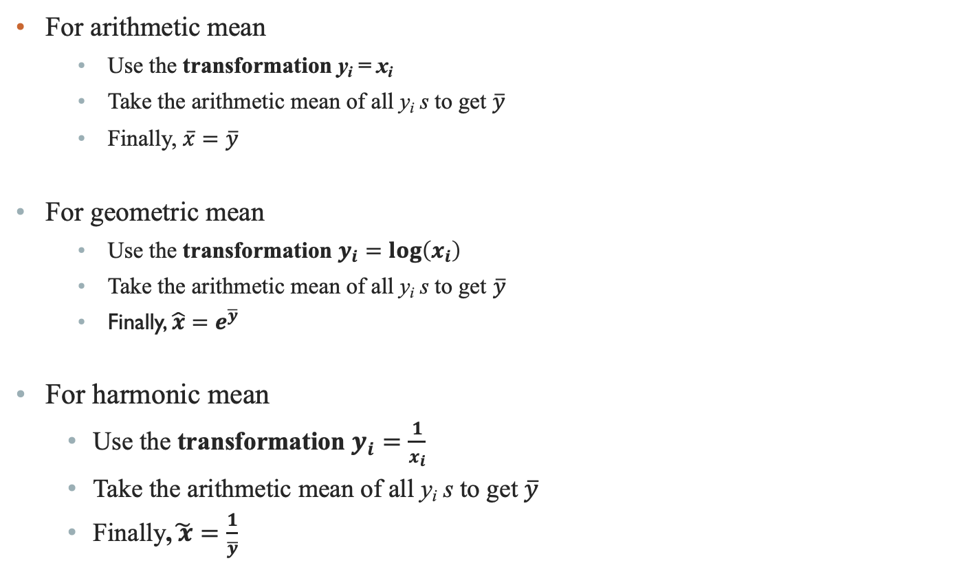
Rule of thumbs for means
For arithmetic mean
Use the transformation y_{i} = x_{i}
Take the arithmetic mean of all y_{i} s to get $\overline{y}$
Finally, $\overline{x}=\overline{y}$
For geometric mean
Use the transformation $y_{i}=log\left(x_{i}\right)$
Take the arithmetic mean of all y_{i} s to get $\overline{y}$
Finally, $\hat{x}=e^{\overline{y}}$
For harmonic mean
Use the transformation $y_{i}=\frac{1}{x_{i}}$
Take the arithmetic mean of all y_{i} s to get $\overline{y}$
Finally,$\tilde{ x}=\frac{1}{\overline{y}}$

Slide 15
Relationship among means
A simple inequality exists between the three means related summary measure as
AM ≥ GM ≥ HM

Slide 16
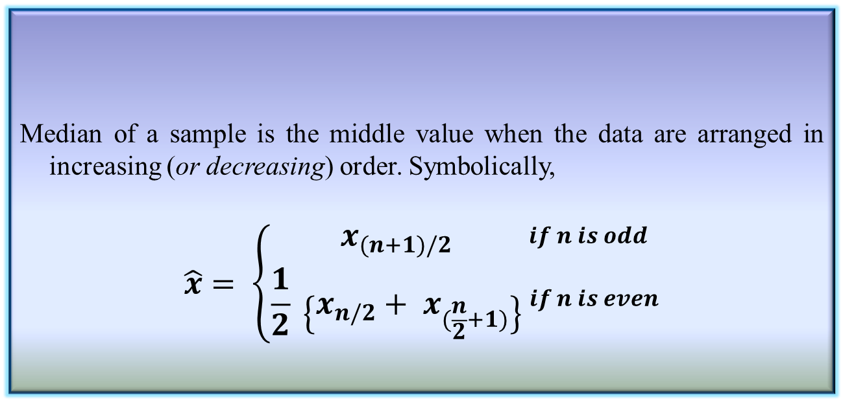
Median of a sample
Median of a sample is the middle value when the data are arranged in increasing (or decreasing) order. Symbolically,
$$\hat{x}= \left\{\begin{aligned}x_{(n+1)/2} \\ \frac{1}{2} \left\{x_{n/2}+ x_{(\frac{n}{2}+1)}\right\}\end{aligned}\right. _{if n is even}^{\begin{aligned}if n is odd \\ \\ \end{aligned}}$$
Definition 3.12: Median of a sample

Slide 17
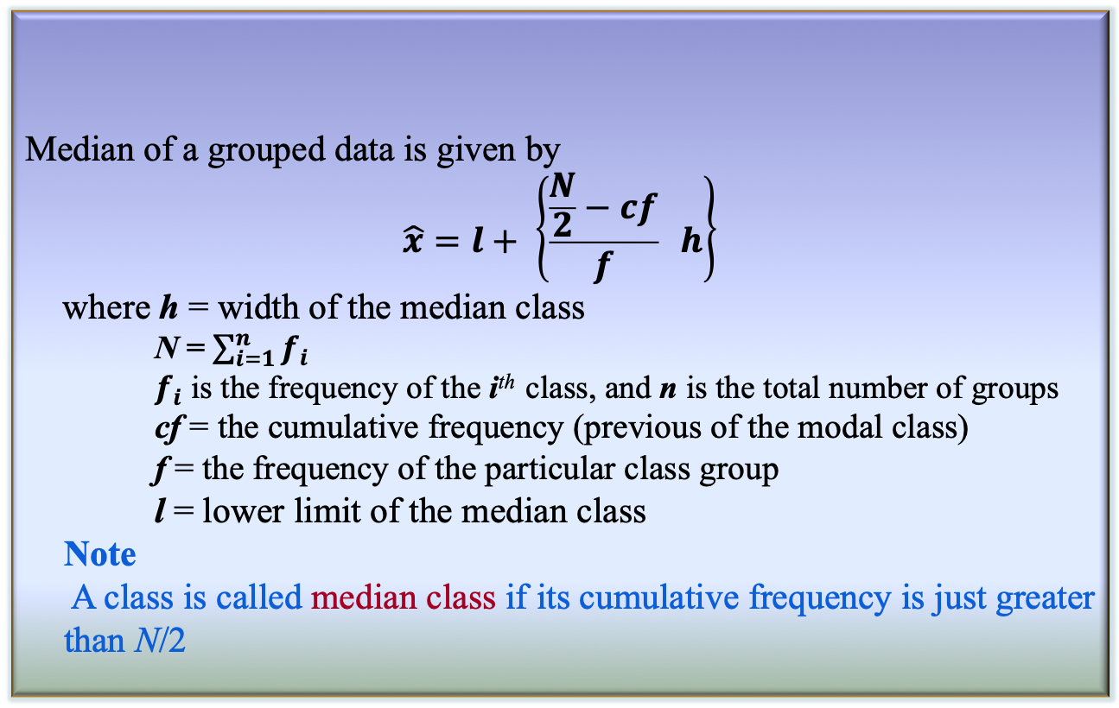
Median of a grouped data
Median of a grouped data is given by
$$\hat{x}=l+ \left\{\frac{\frac{N}{2}−cf}{f} h\right\}$$
where h = width of the median class
N = $\sum_{i=1}^{n}{f_{i}}$
$f_{i}$ is the frequency of the i^{th} class, and n is the total number of groups
cf = the cumulative frequency (previous of the modal class)
f = the frequency of the particular class group
l = lower limit of the median class
Note
A class is called median class if its cumulative frequency is just greater than N/2
Definition 3.12: Median of a grouped data

Slide 19
Mode of a sample
Mode is defined as the observation which occurs most frequently.
For example, number of wickets obtained by bowler in 10 test matches are as follows.
1 2 0 3 2 4 1 1 2 2
In other words, the above data can be represented as:-
Clearly, the mode here is “2”.
 | 0 | 1 | 2 | 3 | 4
# of matches | 1 | 3 | 4 | 1 | 1

Slide 20
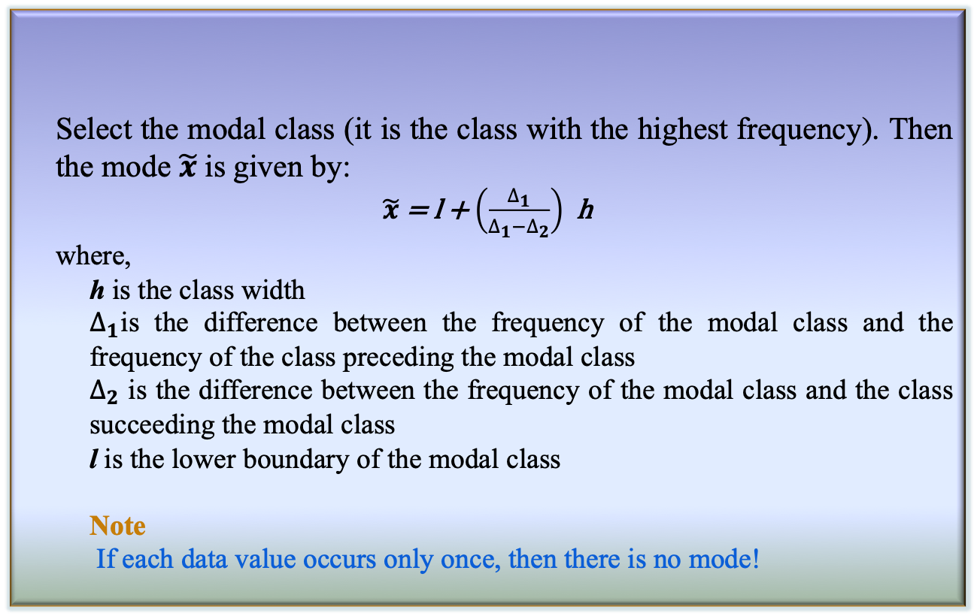
Mode of a grouped data
Select the modal class (it is the class with the highest frequency). Then the mode $\tilde{x}$ is given by:
$\tilde{x}$ = l + $\left(\frac{∆_{1}}{∆_{1}−∆_{2}}\right)$ h
where,
h is the class width
$∆_{1}$is the difference between the frequency of the modal class and the frequency of the class preceding the modal class
$∆_{2}$ is the difference between the frequency of the modal class and the class succeeding the modal class
l is the lower boundary of the modal class
Note
If each data value occurs only once, then there is no mode!
Definition 3.13: Mode of a grouped data

Slide 21
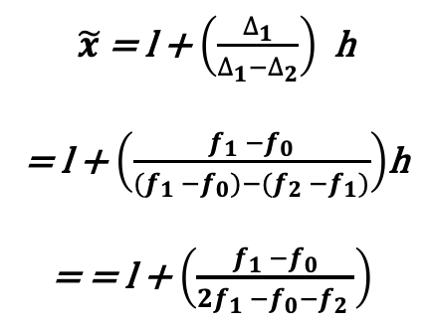
$\tilde{x}$ = l + $\left(\frac{∆_{1}}{∆_{1}−∆_{2}}\right)$ h
= l + $\left(\frac{f_{1} −f_{0}}{{(f}_{1} −f_{0})−{(f}_{2} −f_{1})}\right)$h
= = l + $\left(\frac{f_{1} −f_{0}}{{2f}_{1} −f_{0}−f_{2} }\right)$

Slide 22
Relation between mean, median and mode
A given set of data can be categorized into three categories:-
Symmetric data
Positively skewed data
Negatively skewed data

Slide 23
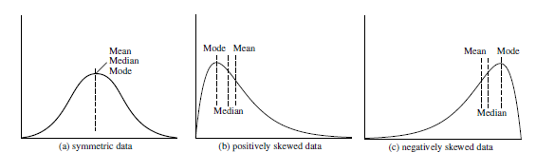
Symmetric data
For symmetric data, all mean, median and mode lie at the same point

Slide 24
Positively skewed data
Here, mode occurs at a value smaller than the median

Slide 25
Negatively skewed data
Here, mode occurs at a value greater than the median

Slide 26
Empirical Relation!
There is an empirical relation, valid for moderately skewed data
Mean – Mode = 3 * (Mean – Median)

Slide 27
Midrange
It is the average of the largest and smallest values in the set.
Find the midrange for the following set of numbers:
2, 4, 7, 10, 14, 35
Midrange = ?

Slide 28
Examples
Raghav received the following scores on his mathematics exams: 84, 92, 74, 98, and 82. Find the mean, median, and mode of his scores.
During a seven-day period in July, a meteorologist recorded that the median daily high temperature was 91º.Which of the following are true statements?
i) The high temperature was exactly 91º on each of the seven days.
ii) The high temperature was never lower than 92º.
iii) Half the high temperatures were above 91º and half were below 91º.
A) i only
B) ii only
C) iii only
D) i, ii, and iii

Slide 29
Measures of dispersion
Location measure are far too insufficient to understand data.
Another set of commonly used summary statistics for continuous data are those that measure the dispersion.
A dispersion measures the extent of spread of observations in a sample.
Some important measure of dispersion are:
Range
Variance and Standard Deviation
Mean Absolute Deviation (MAD)
Absolute Average Deviation (AAD)
Interquartile Range (IQR)

Slide 30
Measures of dispersion
Example
Suppose, two samples of fruit juice bottles from two companies A and B. The unit in each bottle is measured in litre.
Both samples have same mean. However, the bottles from company A with more uniform content than company B.
We say that the dispersion (or variability) of the observation from the average is less for A than sample B.
The variability in a sample should display how the observation spread out from the average
In buying juice, customer should feel more confident to buy it from A than B
Sample A | 0.97 | 1.00 | 0.94 | 1.03 | 1.06
Sample B | 1.06 | 1.01 | 0.88 | 0.91 | 1.14

Slide 31
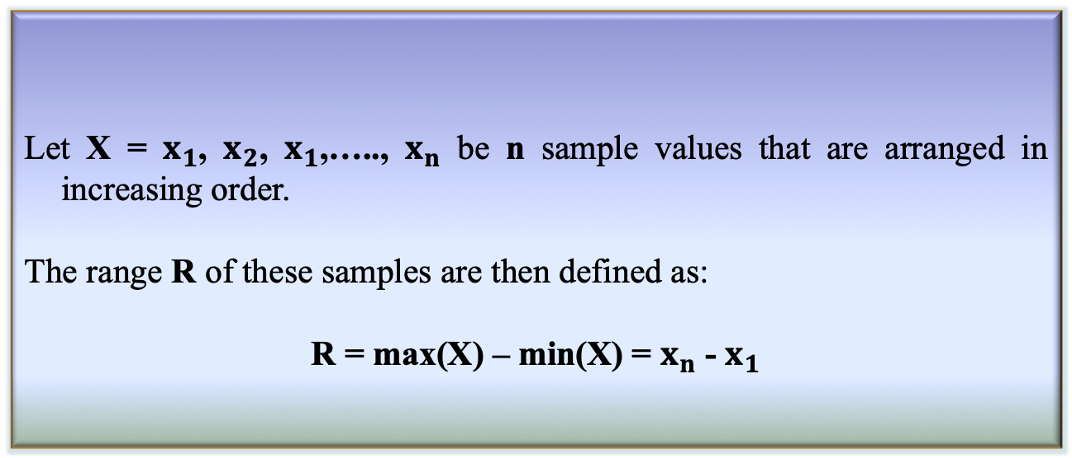
Range of a sample
Definition 3.14: Range of a sample
Let X = $x_{1}$, $x_{2}$, $x_{1}$,….., $x_{n}$ be n sample values that are arranged in increasing order.
The range R of these samples are then defined as:
R = max(X) – min(X) = $x_{n}$ - $x_{1}$
Range identifies the maximum spread, it can be misleading if most of the values are concentrated in a narrow band of values, but there are also a relatively small number of more extreme values.
The variance is another measure of dispersion to deal with such a situation.

Slide 32
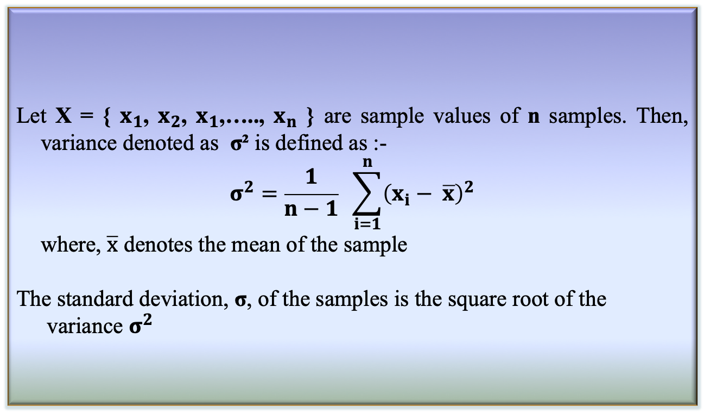
Variance and Standard Deviation
Let X = { $x_{1}$, $x_{2}$, $x_{1}$,….., $x_{n}$ } are sample values of n samples. Then, variance denoted as σ² is defined as :-
$$σ^{2}=\frac{1}{n−1} \sum_{i=1}^{n}{{\left(x_{i}− \overline{x}\right)}^{2}}$$
where, $\overline{x}$ denotes the mean of the sample
The standard deviation, σ, of the samples is the square root of the variance $σ^{2}$
Definition 3.15: Variance and Standard Deviation

Slide 33
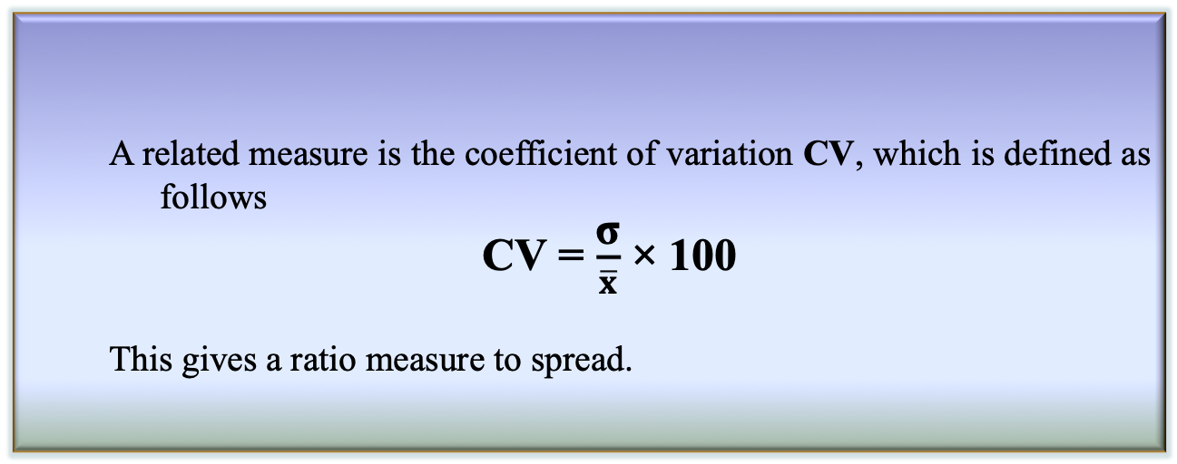
Coefficient variation
Basic properties
σ measures spread about mean and should be chosen only when the mean is chosen as the measure of central tendency
σ = 0 only when there is no spread, that is, when all observations have the same value, otherwise σ > 0
A related measure is the coefficient of variation CV, which is defined as follows
CV = $\frac{\text{σ}}{\overline{x}}$ × 100
This gives a ratio measure to spread.
Definition 3.16: Coefficient variation

Slide 34
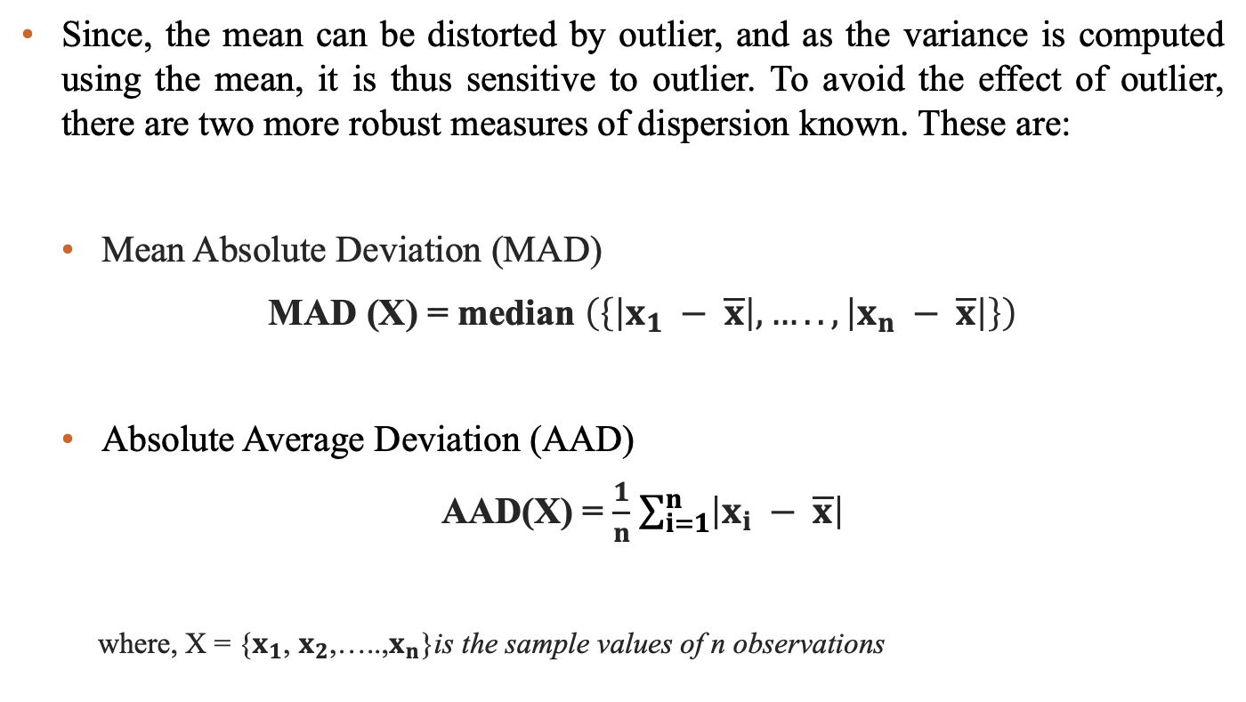
Mean Absolute Deviation (MAD)
Since, the mean can be distorted by outlier, and as the variance is computed using the mean, it is thus sensitive to outlier. To avoid the effect of outlier, there are two more robust measures of dispersion known. These are:
Mean Absolute Deviation (MAD)
MAD (X) = median $\left(\left\{\left|x_{1} − \overline{x}\right|,…..,\left|x_{n} − \overline{x}\right|\right\}\right)$
Absolute Average Deviation (AAD)
AAD(X) = $\frac{1}{n}$ $\sum_{i=1}^{n}{\left|x_{i} − \overline{x}\right|}$
where, X = {$x_{1}$, $x_{2}$,…..,$x_{n}$}is the sample values of n observations

Slide 35
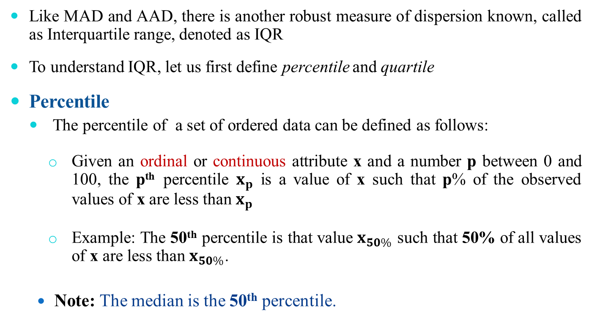
Interquartile Range
Like MAD and AAD, there is another robust measure of dispersion known, called as Interquartile range, denoted as IQR
To understand IQR, let us first define percentile and quartile
Percentile
The percentile of a set of ordered data can be defined as follows:
Given an ordinal or continuous attribute x and a number p between 0 and 100, the p^{th} percentile $x_{p}$ is a value of x such that p% of the observed values of x are less than $x_{p}$
Example: The 50th percentile is that value $x_{50\%}$ such that 50% of all values of x are less than $x_{50\%}$.
Note: The median is the 50th percentile.

Slide 36
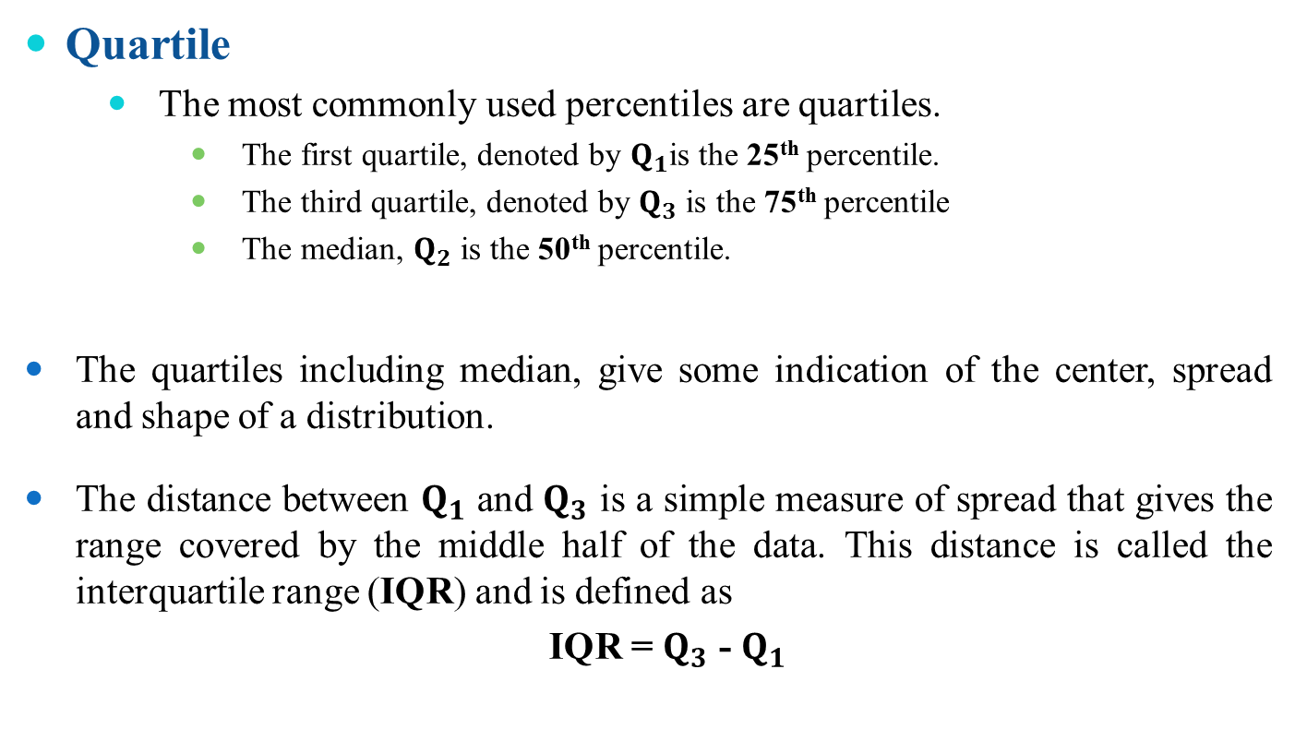
Interquartile Range
Quartile
The most commonly used percentiles are quartiles.
The first quartile, denoted by $Q_{1}$is the 25th percentile.
The third quartile, denoted by $Q_{3}$ is the 75th percentile
The median, $Q_{2}$ is the 50th percentile.
The quartiles including median, give some indication of the center, spread and shape of a distribution.
The distance between $Q_{1}$ and $Q_{3}$ is a simple measure of spread that gives the range covered by the middle half of the data. This distance is called the interquartile range (IQR) and is defined as
IQR = $Q_{3}$ - $Q_{1}$

Slide 37
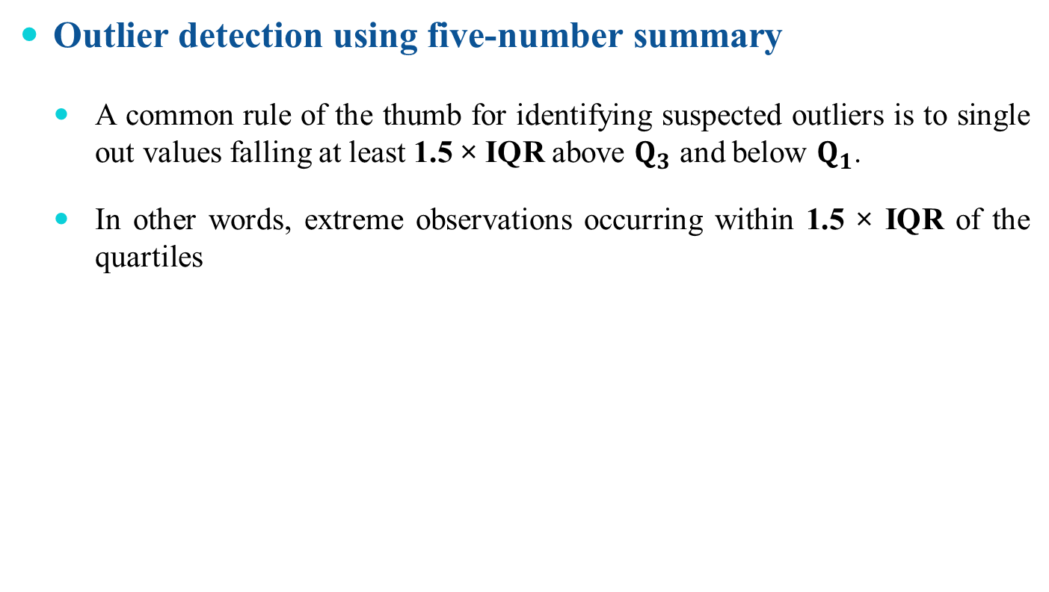
Application of IQR
Outlier detection using five-number summary
A common rule of the thumb for identifying suspected outliers is to single out values falling at least 1.5 × IQR above $Q_{3}$ and below $Q_{1}$.
In other words, extreme observations occurring within 1.5 × IQR of the quartiles

Slide 38
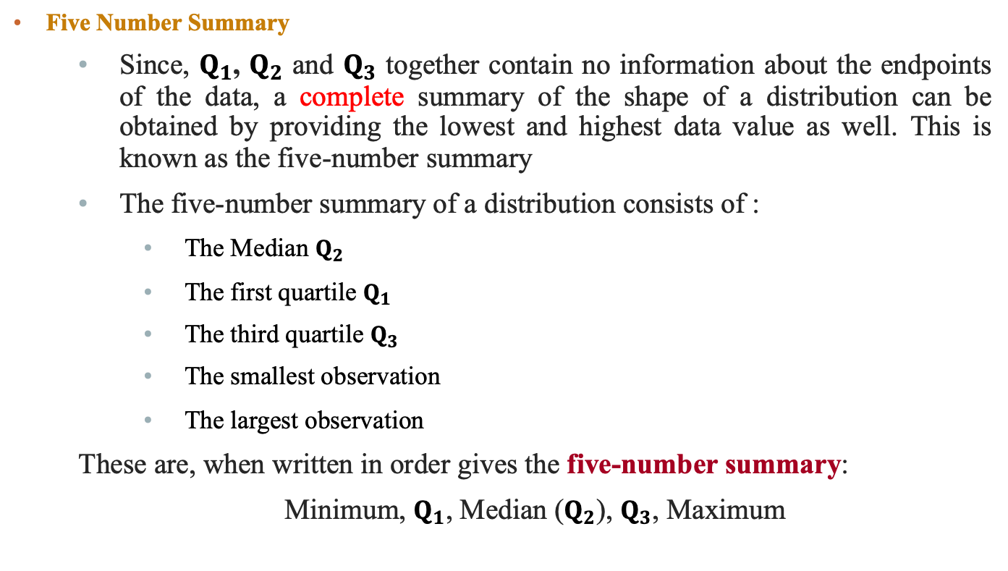
Application of IQR
Five Number Summary
Since, $Q_{1}$, $Q_{2}$ and $Q_{3}$ together contain no information about the endpoints of the data, a complete summary of the shape of a distribution can be obtained by providing the lowest and highest data value as well. This is known as the five-number summary
The five-number summary of a distribution consists of :
The Median $Q_{2}$
The first quartile $Q_{1}$
The third quartile $Q_{3}$
The smallest observation
The largest observation
These are, when written in order gives the five-number summary:
Minimum, $Q_{1}$, Median ($Q_{2}$), $Q_{3}$, Maximum

Slide 39
Box plot
Graphical view of Five number summary

Slide 40
Reference
The detail material related to this lecture can be found in
Probability and Statistics for Enginneers and Scientists (8th Ed.) by Ronald E. Walpol, Sharon L. Myers, Keying Ye (Pearson), 2013 .

Slide 41
Questions of the day…
Which of the following central tendency measurements allows distributive, algebraic and holistic measure?
mean
median
Mode
Which measure may be faster than other? Why?
Give three situations where AM, GM and HM are the right measure of central tendency?

Slide 42
Questions of the day…
Given a sample of data, how to decide whether it is
Symmetric?
Skew-symmetric (positive or negative)?
Uniformly increasing (or decreasing)?
In-variate?
How the box-plots will look for the following types of samples?
a) Symmetric b) Positively skew-symmetric
c) Negatively skew-symmetric d) in-variate

Slide 43
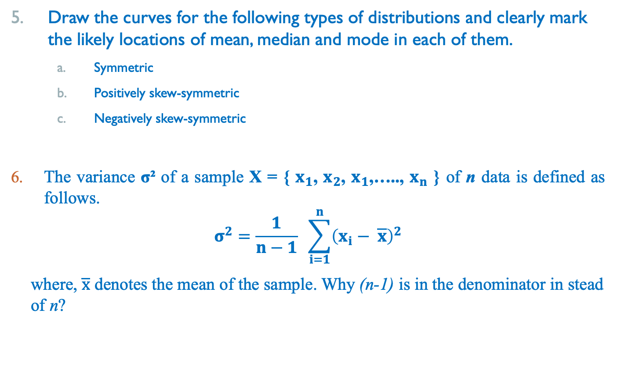
Questions of the day…
Draw the curves for the following types of distributions and clearly mark the likely locations of mean, median and mode in each of them.
Symmetric
Positively skew-symmetric
Negatively skew-symmetric
The variance σ² of a sample X = { $x_{1}$, $x_{2}$, $x_{1}$,….., $x_{n}$ } of n data is defined as follows.
$$σ^{2}=\frac{1}{n−1} \sum_{i=1}^{n}{{\left(x_{i}− \overline{x}\right)}^{2}}$$
where, $\overline{x}$ denotes the mean of the sample. Why (n-1) is in the denominator in stead of n?

Slide 44
Questions of the day…
7. What are the degree of freedoms in each of the following cases.
A sample with a single data
A sample with n data
A sample of tabular data with n rows and m columns

